Slide 1

Modern Practices in Business Forecasting:
www.linkedin.com/in/filotas-theodosiou
www.linkedin.com/in/filotas-theodosiou
Insights From the Success Story of Gradient Boosting Decision Trees (GBDTs)
Filotas Theodosiou
Contact Details:
- filotas.theodosiou@vives.be
- www.linkedin.com/in/filotas-theodosiou

Slide 2
- Agenda
A Brief Overview of Business Forecasting
Introduction to Gradient Boosting Decision Trees (GBDTs)
Real World Implementations & Practical Tips.
Deployment in Production: Suggestions & Potential Pitfalls

Slide 3
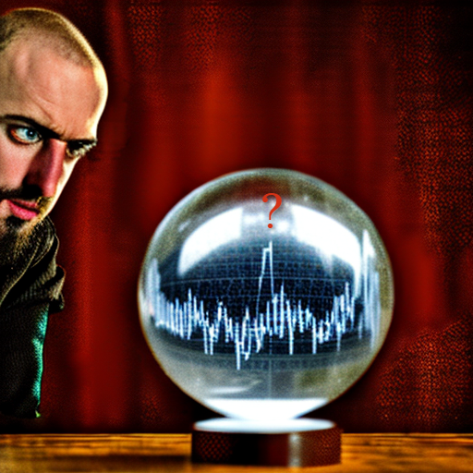
A Brief Overview of Business Forecasting
Section 1.
What is the Point of Forecasting?
Why Consider Forecasting Systems in your Business?
What to Actual Forecast?
The Missing Key to the Puzzle.

Slide 4
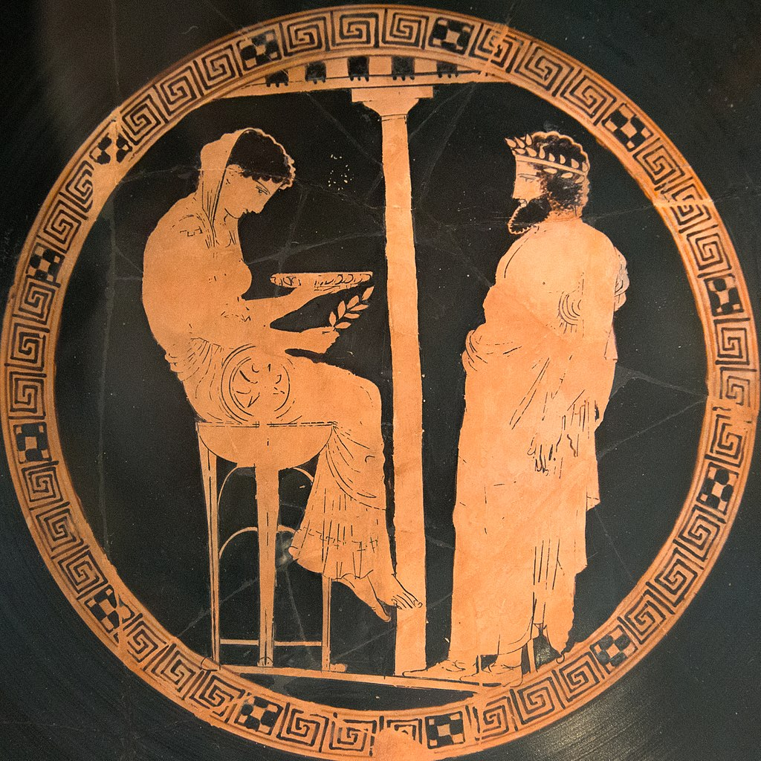
What is the Point of Forecasting
“A wall of wood alone shall be uncaptured, a boon to you and your children”, 480 BC
- Herodotus, The Persian Wars, Volume 1
King Algeus in front of Pythia at the Oracle of Delphi, 440-430 BC

Slide 5
Why do we Consider Forecasting Systems?
Quick answer: Assist in our Decision Making.

Slide 6
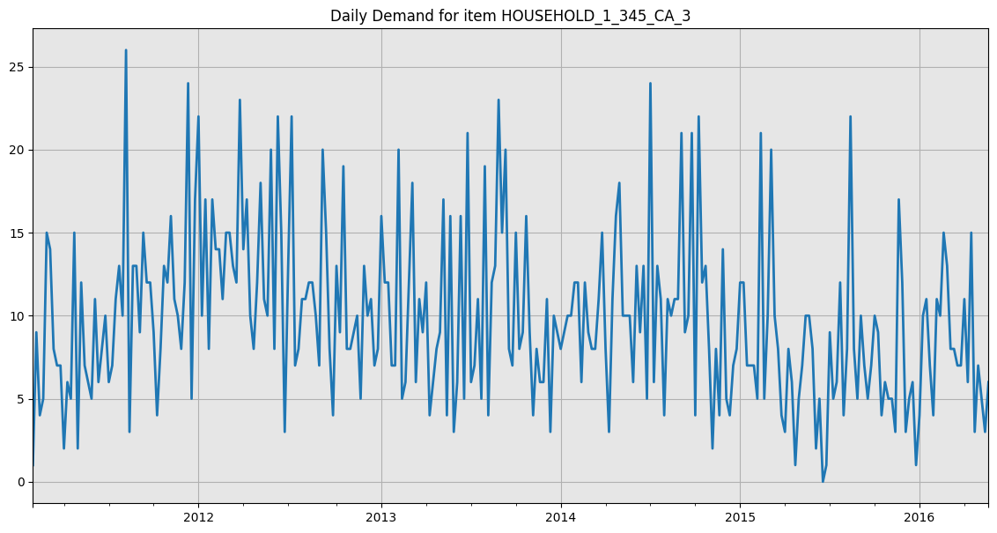
Why do we Consider Forecasting Systems?
Quick answer: Assist in our Decision Making.
Example: Inventory Replenishment

Slide 7
Why do we Consider Forecasting Systems?
Quick answer: Assist in our Decision Making.
Example: Inventory Replenishment
But…
What about our managers?
What about our years of experience?

Slide 8
Why do we Consider Forecasting Systems?
Quick answer: Assist in our Decision Making.
Example: Inventory Replenishment
But…
What about our managers?
What about our years of experience?
Biases & Noises*

Slide 9
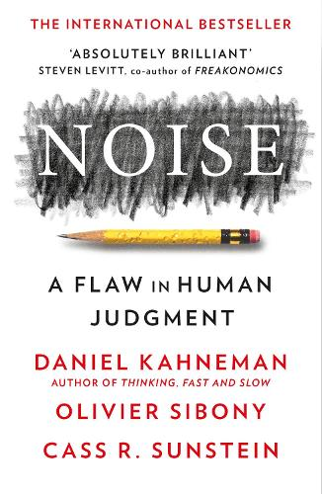
Why do we Consider Forecasting Systems?
Quick answer: Assist in our Decision Making.
Example: Inventory Replenishment
But…
What about our managers?
What about our years of experience?
Biases & Noises*
Kahneman, Daniel, Olivier Sibony, and Cass R. Sunstein. Noise: a flaw in human judgment. Hachette UK, 2021.

Slide 10
Why do we Consider Forecasting Systems?
Quick answer: Assist in our Decision Making.
Example: Inventory Replenishment
But…
What about our managers?
What about our years of experience?
Biases & Noises*
Limited brain capacity
Kahneman, Daniel, Olivier Sibony, and Cass R. Sunstein. Noise: a flaw in human judgment. Hachette UK, 2021.

Slide 11
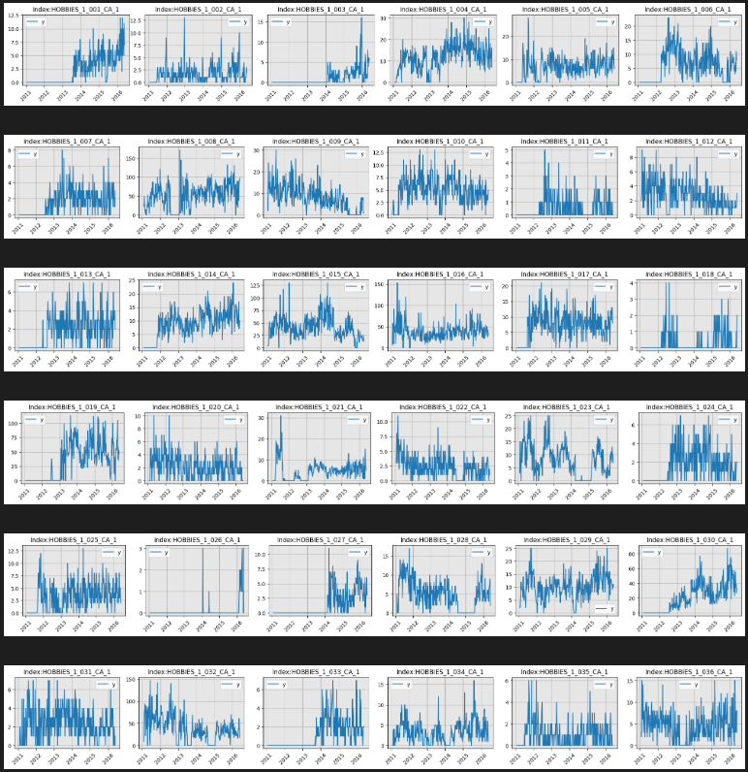
Why do we Consider Forecasting Systems?
Quick answer: Assist in our Decision Making.
Example: Inventory Replenishment
But…
What about our managers?
What about our years of experience?
Biases & Noises*
Limited brain capacity
Kahneman, Daniel, Olivier Sibony, and Cass R. Sunstein. Noise: a flaw in human judgment. Hachette UK, 2021.

Slide 12
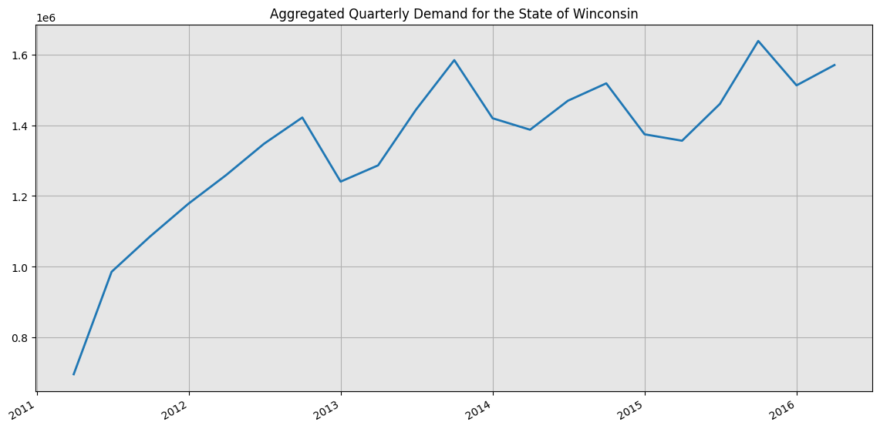
What to Actually Forecast
Different types of forecasts for different organization decisions
Strategic Forecasts
Operational Forecasts
Small number of time series
Long Forecasting Horizon
Often no need for forecasting systems
E.g. Possible Expansion
Large number of time series
Short forecasting horizons
Forecasting systems & high degree of automation is needed
E.g. Inventory Replenishment
Januschowski, Tim and Stephan Kolassa "A classification of business forecasting problems". Foresight the International Journal of Applied Forecasting. International Institute of Forecasters (2019). Issue 52

Slide 13
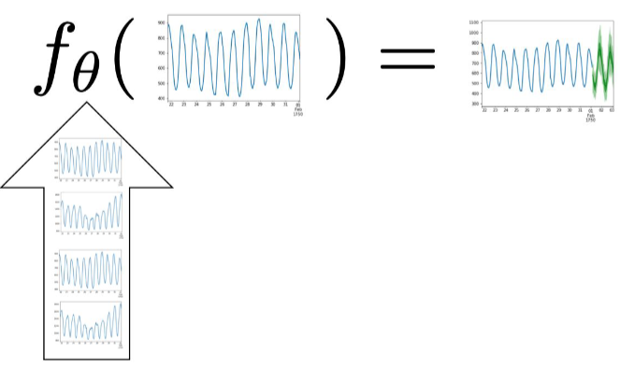
Modern Operational Forecasts: The missing key to the puzzle
Time series A
Local Learning: A model per time series
Most conventional models.
Montero-Manso, Pablo, and Rob J. Hyndman. "Principles and algorithms for forecasting groups of time series: Locality and globality." International Journal of Forecasting 37.4 (2021): 1632-1653.
Gasthaus. Jan & Januschowski , Tim. “Modern Forecasting in Practise, Session 1”, Sphere Online Course. URL: https://www.getsphere.com/cohorts/modern-forecasting-in-practice

Slide 14
Modern Operational Forecasts: The missing key to the puzzle
Time series A
Local Learning: A model per time series
Most conventional models.
Computational issues
10000 models for 10000 time series?
Models of limited capacity.
Most time series have limited historical values to fit a model
Limited data ⬄ Limited number of parameters ⬄ “Simpler” Models.
Montero-Manso, Pablo, and Rob J. Hyndman. "Principles and algorithms for forecasting groups of time series: Locality and globality." International Journal of Forecasting 37.4 (2021): 1632-1653.
Gasthaus. Jan & Januschowski , Tim. “Modern Forecasting in Practise, Session 1”, Sphere Online Course. URL: https://www.getsphere.com/cohorts/modern-forecasting-in-practice

Slide 15

Modern Operational Forecasts: The missing key to the puzzle
Time series A
Local Learning: A model per time series
Most conventional models.
Computational issues
10000 models for 10000 time series?
Models of limited capacity.
Most time series have limited historical values to fit a model
Limited data ⬄ Limited number of parameters ⬄ “Simpler” Models.
Global Learning: A paradigm shift.
Increase the width and not the length
Allow for higher capacity models (NNs, GBDTs, etc..)
Theoretical evidence for improved performance
Time series B
Time series C
Time series D
Time series E
Time series A
Time series B
Time series C
Time series D
Time series E
Width
Length
Montero-Manso, Pablo, and Rob J. Hyndman. "Principles and algorithms for forecasting groups of time series: Locality and globality." International Journal of Forecasting 37.4 (2021): 1632-1653.
Gasthaus. Jan & Januschowski , Tim. “Modern Forecasting in Practise, Session 1”, Sphere Online Course. URL: https://www.getsphere.com/cohorts/modern-forecasting-in-practice

Slide 16
Introduction to Gradient Boosting Decision Trees (GBDTs)
Section 2.
What the Media do not Tell you.
Facts About GBDTs in Forecasting.
The Theory Behind GBDTs.
How to Make GBDTs Work for You.

Slide 17
What the Media Does not Tell you.
Generative Pre-Trained Transformers (GPTs) dominates news.

Slide 18
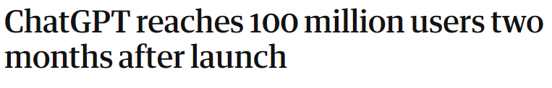
What the Media Does not Tell you.
Generative Pre-Trained Transformers (GPTs) dominates news.

Slide 19
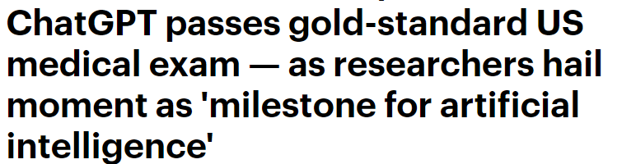
What the Media Does not Tell you.
Generative Pre-Trained Transformers (GPTs) dominates news.

Slide 20
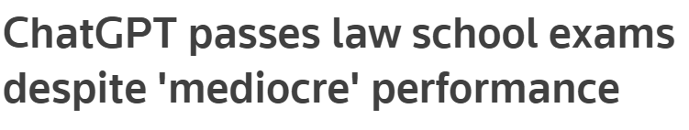
What the Media Does not Tell you.
Generative Pre-Trained Transformers (GPTs) dominates news.

Slide 21
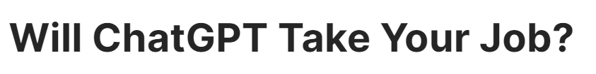
What the Media Does not Tell you.
Generative Pre-Trained Transformers (GPTs) dominates news.

Slide 22
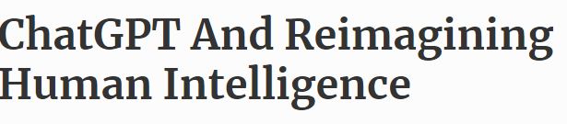
What the Media Does not Tell you.
Generative Pre-Trained Transformers (GPTs) dominates news.

Slide 23
What the Media Does not Tell you.
Generative Pre-Trained Transformers (GPTs) dominates news.

Slide 24
What the Media Does not Tell you.
Generative Pre-Trained Transformers (GPTs) dominates news.

Slide 25
What the Media Does not Tell you.
Generative Pre-Trained Transformers (GPTs) are all over the news.
And for a good reason. They dominate NLP and Computer Vision tasks

Slide 26
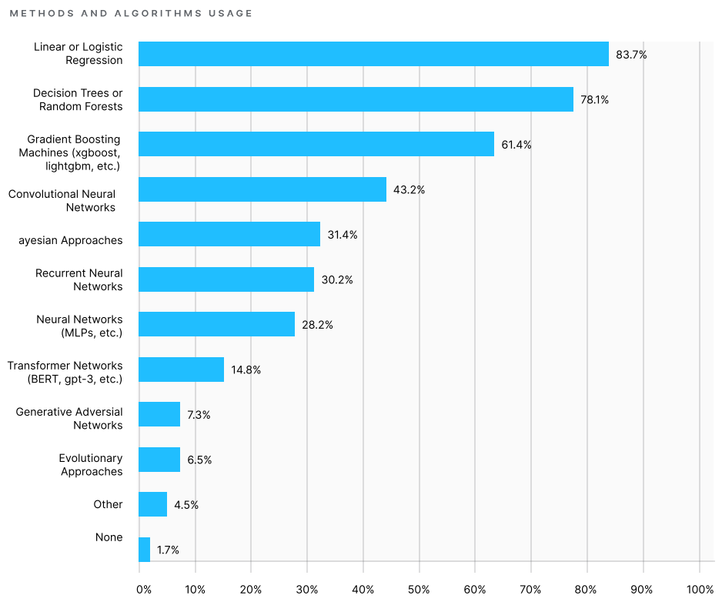
What the Media Does not Tell you.
Kaggle Annual Report 2019
Generative Pre-Trained Transformers (GPTs) are all over the news.
And for a good reason. They dominate NLP and Computer Vision tasks
But:
Industry deals mostly with structured (Tabular) Data.
GBDT models have been dominating applied ML competitions
GBDT models is the most applied ML model in practice
Kaggle is the biggest Data Science Platform with over 10million active users. It is used by educators, practioneres and by big companies (e.g. Walmart, Netflix)

Slide 27
What the Media Does not Tell you.
Kaggle Annual Report 2019
Generative Pre-Trained Transformers (GPTs) are all over the news.
And for a good reason. They dominate NLP and Computer Vision tasks
But:
Industry deals mostly with structured (Tabular) Data.
GBDT models have been dominating applied ML competitions
GBDT models is the most applied ML model in practice
“ The most glaring difference between what is used on Kaggle (real-world datasets) and what is fashionable in academia”
– Antony Goldbloom, CEO of Kaggle when asked about the prominence of GBDTs.
Kaggle is the biggest Data Science Platform with over 10million active users. It is used by educators, practioneres and by big companies (e.g. Walmart, Netflix)

Slide 28
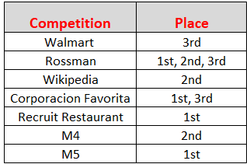
Facts About GBDTs in Forecasting.
2010s Situation: Despite some evidence of performance benefits
Statistical methods were mostly preferred both in academia and practice
Local Neural Networks (and other ML models) as an alternative
Submissions that utilized GBDT models
Bojer, Casper Solheim, and Jens Peder Meldgaard. "Kaggle forecasting competitions: An overlooked learning opportunity." International Journal of Forecasting 37.2 (2021): 587-603.

Slide 29
Facts About GBDTs in Forecasting.
2010s Situation: Despite some evidence of performance benefits
Statistical methods were mostly preferred both in academia and practice
Local Neural Networks (and other ML models) as an alternative
2020 - A critical moment: M5 Forecasting Competion
Submissions that utilized GBDT models
Bojer, Casper Solheim, and Jens Peder Meldgaard. "Kaggle forecasting competitions: An overlooked learning opportunity." International Journal of Forecasting 37.2 (2021): 587-603.

Slide 30
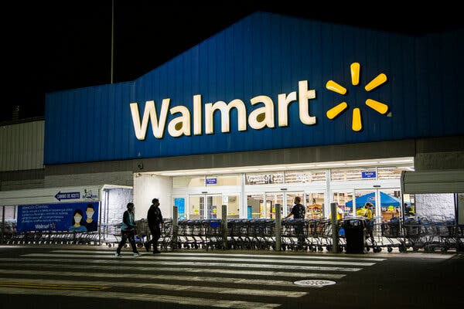
Facts About GBDTs in Forecasting.
2010s Situation: Despite some evidence of performance benefits
Statistical methods were mostly preferred both in academia and practice
Local Neural Networks (and other ML models) as an alternative
2020 - A critical moment: M5 Forecasting Competion
The biggest forecasting competition (over 6000 participating teams)
Walmart Retail Forecasting (42.840 daily time series)
Submissions that utilized GBDT models
Bojer, Casper Solheim, and Jens Peder Meldgaard. "Kaggle forecasting competitions: An overlooked learning opportunity." International Journal of Forecasting 37.2 (2021): 587-603.

Slide 31
Facts About GBDTs in Forecasting.
2010s Situation: Despite some evidence of performance benefits
Statistical methods were mostly preferred both in academia and practice
Local Neural Networks (and other ML models) as an alternative
2020 - A critical moment: M5 Forecasting Competion
The biggest forecasting competition (over 6000 participating teams)
Walmart Retail Forecasting (42.840 daily time series)
GBDTs (and Global Learning) dominated the competition.
Heavily outperformed statistical bencmarks
Accuracy improvement over Deep Learning Models
Socking moment: 59th place with 0 model optimization
Submissions that utilized GBDT models
Bojer, Casper Solheim, and Jens Peder Meldgaard. "Kaggle forecasting competitions: An overlooked learning opportunity." International Journal of Forecasting 37.2 (2021): 587-603.

Slide 32

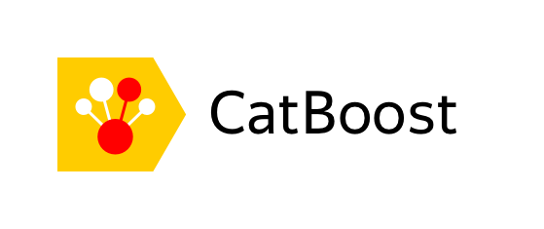

The Theory Behind GBDTs: Decision Trees -> Bagging->Boosting

Slide 33
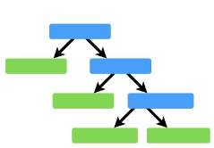
The Theory Behind GBDTs: Decision Trees -> Bagging->Boosting
Decision Trees
Weak Base Learner
Very simple model
Splits features at nodes
Takes the average

Slide 34
The Theory Behind GBDTs: Decision Trees -> Bagging->Boosting
Decision Trees
Bagging (Random Forest)
Weak Base Learner
Very simple model
Splits features at nodes
Takes the average
Combines multiple weak learners
Fit a unique tree to different data samples
Combines independent predictions (Partially) Deals with overfitting
Cannot extrapolate.

Slide 35
The Theory Behind GBDTs: Decision Trees -> Bagging->Boosting
Decision Trees
Bagging (Random Forest)
Boosting: (GBDTs)
Get prediction
Calculate error
Predict Error
Calculate Error
Predict Error
Calculate Error
Predict Error
Calculate Error
Weak Base Learner
Very simple model
Splits features at nodes
Takes the average
Combines multiple weak learners
Fit a unique tree to different data samples
Combines independent predictions (Partially) Deals with overfitting
Cannot extrapolate.
Combines multiple weak learners
Fits trees sequentially instead of parallel
Iteratively corrects errors of the previous tree
(Partially) Deals with overfitting
Cannot extrapolate.

Slide 36
The Theory Behind GBDTs: Modelling the Feature Space
GBDTs: Decision Trees for Different Sets of Features:
Different weak learners for diverse features
Informative feature space ⬄ More holistic view for the task.
Neural Networks: Transform the Feature Space
Multiple affine transformations
Find a meaningful representation of the feature space
Original Example: Chollet, Francois. Deep learning with Python. Simon and Schuster, 2021.

Slide 37

The Theory Behind GBDTs: Modelling the Feature Space
Imaginary Problem:
Count dots inside the folded paper
GBDTs: Decision Trees for Different Sets of Features:
Different weak learners for diverse features
Informative feature space ⬄ More holistic view for the task.
Neural Networks: Transform the Feature Space
Multiple affine transformations
Find a meaningful representation of the feature space
Original Example: Chollet, Francois. Deep learning with Python. Simon and Schuster, 2021.

Slide 38
The Theory Behind GBDTs: Modelling the Feature Space
Imaginary Problem:
Count dots inside the folded paper
GBDTs: Decision Trees for Different Sets of Features:
Different weak learners for diverse features
Informative feature space ⬄ More holistic view for the task.
Neural Networks: Transform the Feature Space
Multiple affine transformations
Find a meaningful representation of the feature space
Unfold the paper (given enough data) and count
Original Example: Chollet, Francois. Deep learning with Python. Simon and Schuster, 2021.

Slide 39
The Theory Behind GBDTs: Modelling the Feature Space
Imaginary Problem:
Count dots inside the folded paper
GBDTs: Decision Trees for Different Sets of Features:
Different weak learners for diverse features
Informative feature space ⬄ More holistic view for the task.
Require a detailed description of the problem
(eg paper size, average number of dots, total folds etc)
Neural Networks: Transform the Feature Space
Multiple affine transformations
Find a meaningful representation of the feature space
Unfold the paper (given enough data) and count
Original Example: Chollet, Francois. Deep learning with Python. Simon and Schuster, 2021.

Slide 40
The Theory Behind GBDTs: Modelling the Feature Space
Imaginary Problem:
Count dots inside the folded paper
GBDTs: Decision Trees for Different Sets of Features:
Different weak learners for diverse features
Informative feature space ⬄ More holistic view for the task.
Require a detailed description of the problem
(eg paper size, average number of dots, total folds etc)
Neural Networks: Transform the Feature Space
Multiple affine transformations
Find a meaningful representation of the feature space
Unfold the paper (given enough data) and count
Main Takeaway: GBDTs excel when given an accurate feature space
Original Example: Chollet, Francois. Deep learning with Python. Simon and Schuster, 2021.

Slide 41
How to Make GBDTs Work: The Importance of Feature Engineering
Feature Selection & Engineering is the most crucial step when forecasting with GBDTs

Slide 42
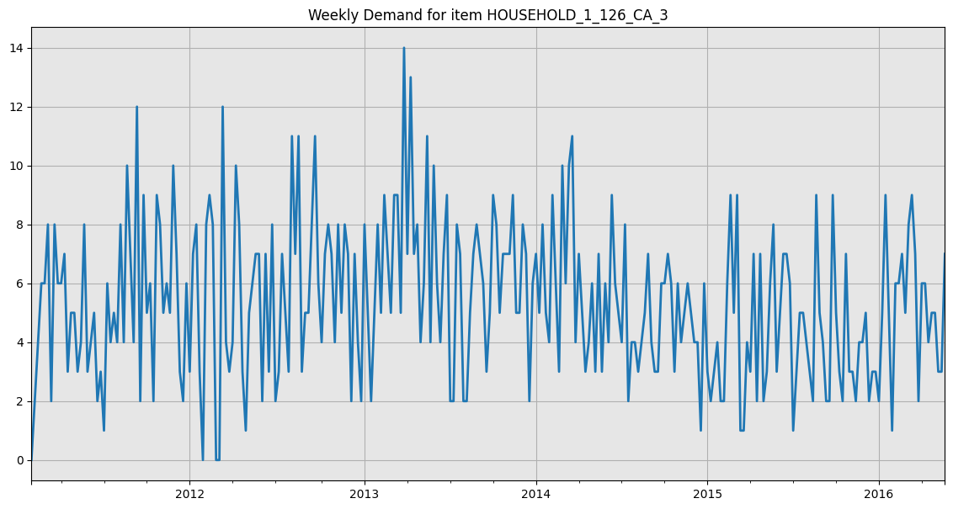
How to Make GBDTs Work: The Importance of Feature Engineering
Feature Selection & Engineering is the most crucial step when forecasting with GBDTs
Provide A Detailed Description.

Slide 43
How to Make GBDTs Work: The Importance of Feature Engineering
Feature Selection & Engineering is the most crucial step when forecasting with GBDTs
Provide A Detailed Description.
Recent History

Slide 44
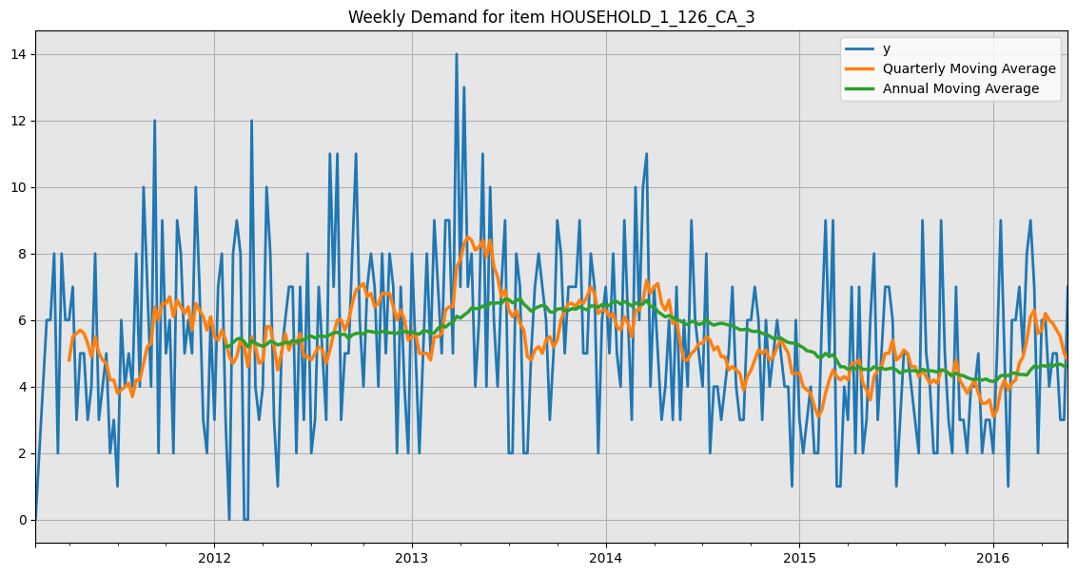
How to Make GBDTs Work: The Importance of Feature Engineering
Feature Selection & Engineering is the most crucial step when forecasting with GBDTs
Provide A Detailed Description.
Recent History
Trend

Slide 45
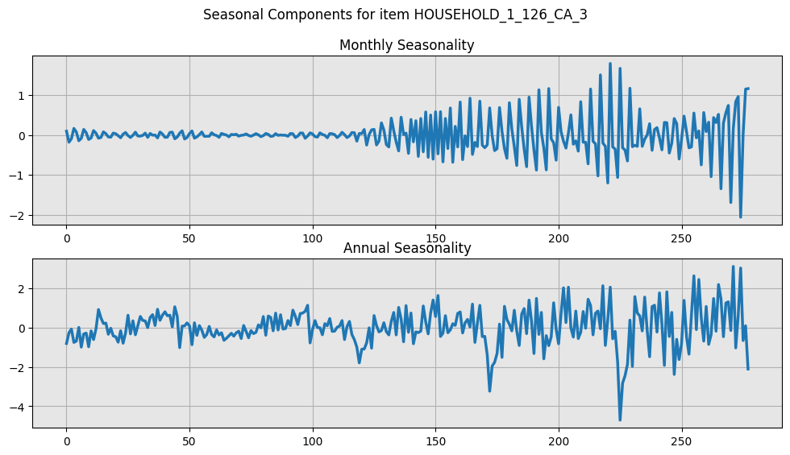
How to Make GBDTs Work: The Importance of Feature Engineering
Feature Selection & Engineering is the most crucial step when forecasting with GBDTs
Provide A Detailed Description.
Recent History
Trend
Seasonality

Slide 46
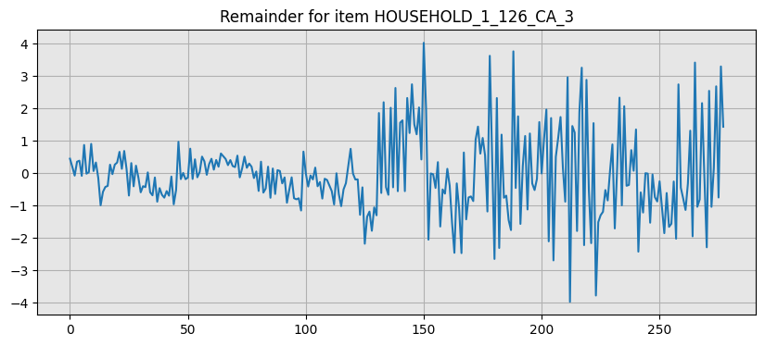
How to Make GBDTs Work: The Importance of Feature Engineering
Feature Selection & Engineering is the most crucial step when forecasting with GBDTs
Provide A Detailed Description.
Recent History
Trend
Seasonality
Question:
What about the reminder?
Is it just random fluctuations?

Slide 47
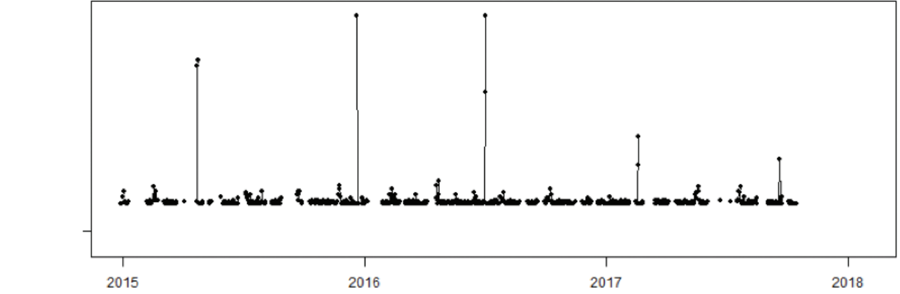
How to Make GBDTs Work: The Importance of Context Expertise
Scenario 1
Januschowski, Tim and Stephan Kolassa "A classification of business forecasting problems". Foresight the International Journal of Applied Forecasting. International Institute of Forecasters (2019). Issue 52
Gasthaus. Jan & Januschowski , Tim. “Modern Forecasting in Practise, Session 2”, Sphere Online Course. URL: https://www.getsphere.com/cohorts/modern-forecasting-in-practice

Slide 48
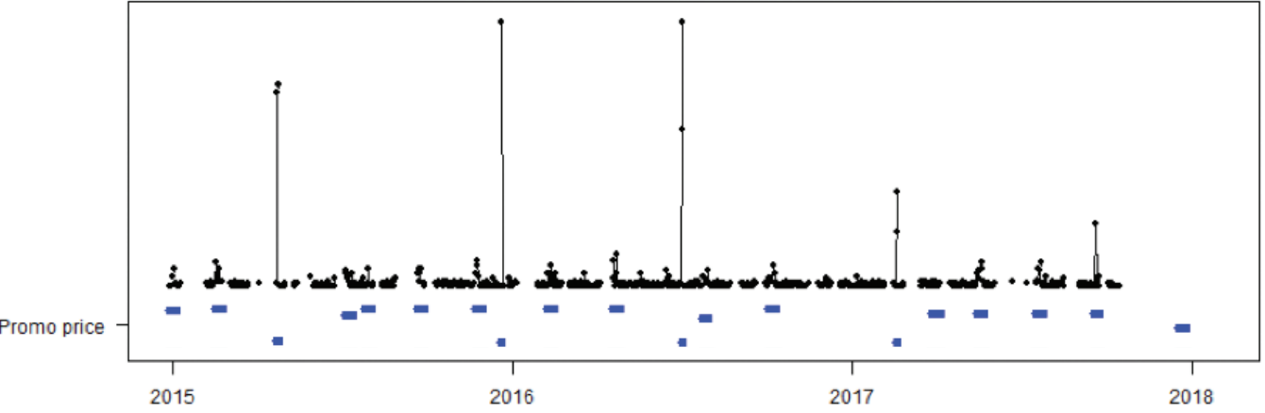
How to Make GBDTs Work: The Importance of Context Expertise
Promotions & Discounts
Scenario 1

Slide 49
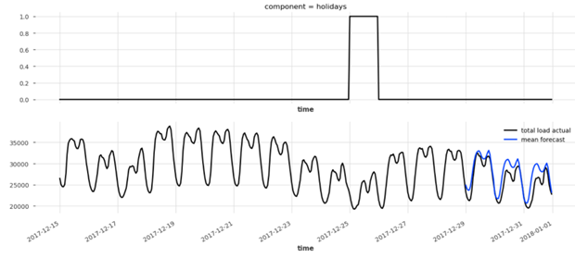
How to Make GBDTs Work: The Importance of Context Expertise
Promotions & Discounts
Scenario 1
Scenario 2
Januschowski, Tim and Stephan Kolassa "A classification of business forecasting problems". Foresight the International Journal of Applied Forecasting. International Institute of Forecasters (2019). Issue 52
Gasthaus. Jan & Januschowski , Tim. “Modern Forecasting in Practise, Session 2”, Sphere Online Course. URL: https://www.getsphere.com/cohorts/modern-forecasting-in-practice

Slide 50
How to Make GBDTs Work: The Importance of Context Expertise
Holidays & Special Events
Promotions & Discounts
Scenario 1
Scenario 2
Januschowski, Tim and Stephan Kolassa "A classification of business forecasting problems". Foresight the International Journal of Applied Forecasting. International Institute of Forecasters (2019). Issue 52
Gasthaus. Jan & Januschowski , Tim. “Modern Forecasting in Practise, Session 2”, Sphere Online Course. URL: https://www.getsphere.com/cohorts/modern-forecasting-in-practice

Slide 51
How to Make GBDTs Work: The Importance of Context Expertise
Holidays & Special Events
Promotions & Discounts
Scenario 1
Scenario 2
Main takeaway: Provide all information available to maximize the efficiency of the model
Januschowski, Tim and Stephan Kolassa "A classification of business forecasting problems". Foresight the International Journal of Applied Forecasting. International Institute of Forecasters (2019). Issue 52
Gasthaus. Jan & Januschowski , Tim. “Modern Forecasting in Practise, Session 2”, Sphere Online Course. URL: https://www.getsphere.com/cohorts/modern-forecasting-in-practice

Slide 52
Real-World Implementations & Practical Tips
Section 3.
PWO Example 1: Sales Forecasting
PWO Example 2: Explainable Student Exam Grades Predictions
Justified or Not?
The Case Against Statistical Models
The Bandwagon of Deep Learning

Slide 53
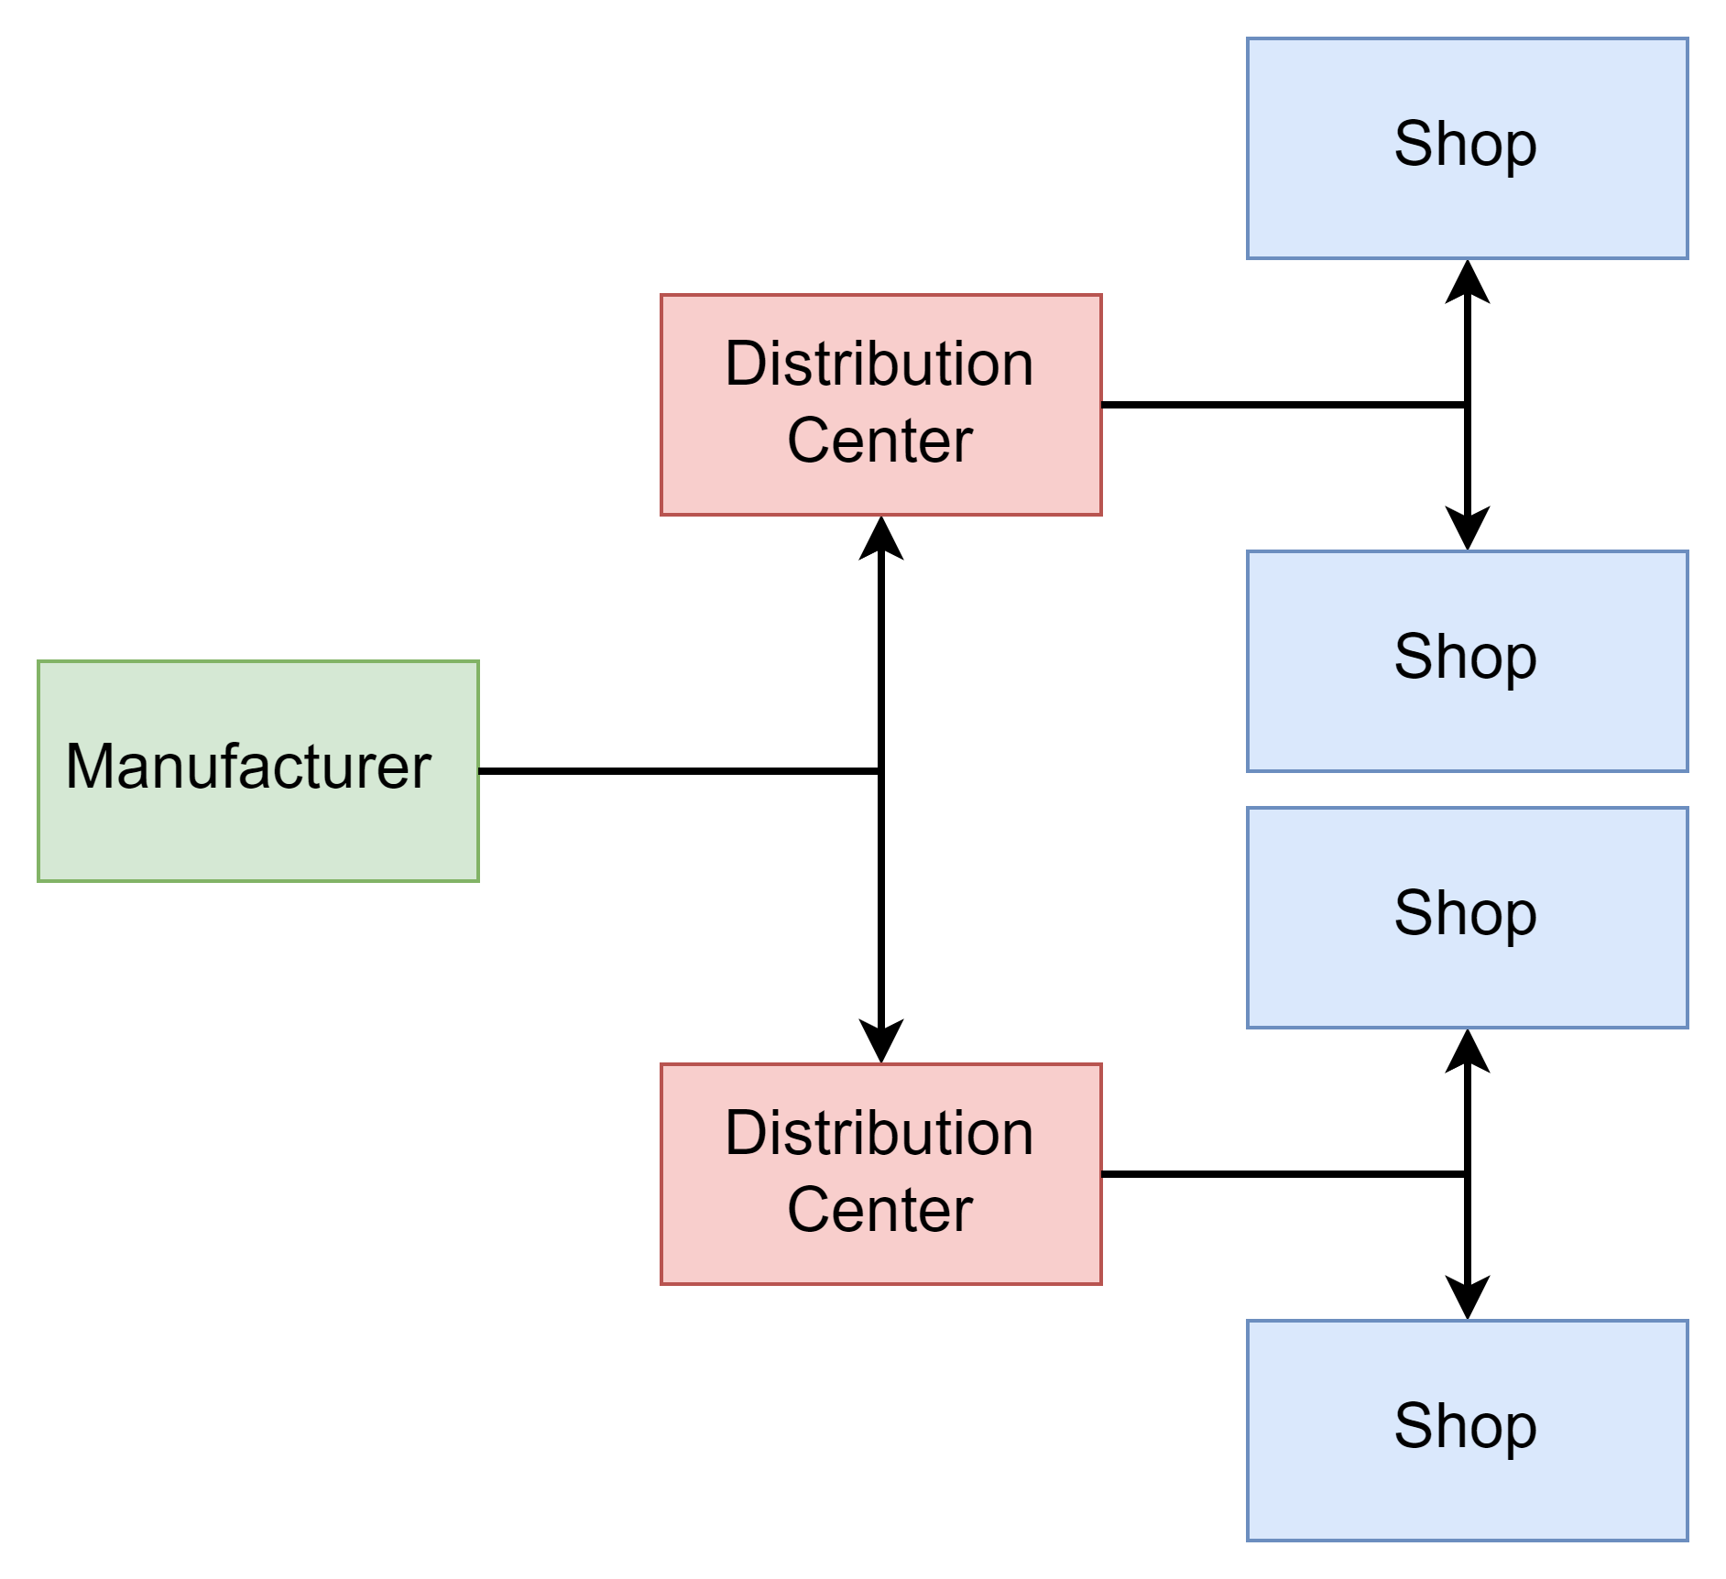
PWO Example 1: Sales Forecasting
Situation: Collaboration in a retail supply chain(add picture of supply chain)
Retailer orders weekly from a DC
DCs order bi-weekly from a Supplier
Supplier orders raw products every month.

Slide 54
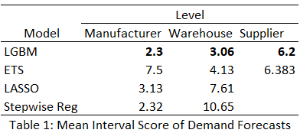
PWO Example 1: Sales Forecasting
Situation: Collaboration in a retail supply chain(add picture of supply chain)
Retailer orders weekly from a DC
DCs order bi-weekly from a Supplier
Supplier orders raw products every month.
Aim: Reduce the overall inventory across the supply chain.
Use LGBM to predict the demand for each level
Feed the predictions to Neural Network to align them

Slide 55
PWO Example 1: Sales Forecasting
Situation: Collaboration in a retail supply chain(add picture of supply chain)
Retailer orders weekly from a DC
DCs order bi-weekly from a Supplier
Supplier orders row products every month.
Aim: Reduce the overall inventory across the supply chain.
Use LGBM to predict the demand for each level
Feed the predictions to Neural Network to align them
Main Takeaway: Accuracy improvements regardless the hierarchical & the temporal level.

Slide 56
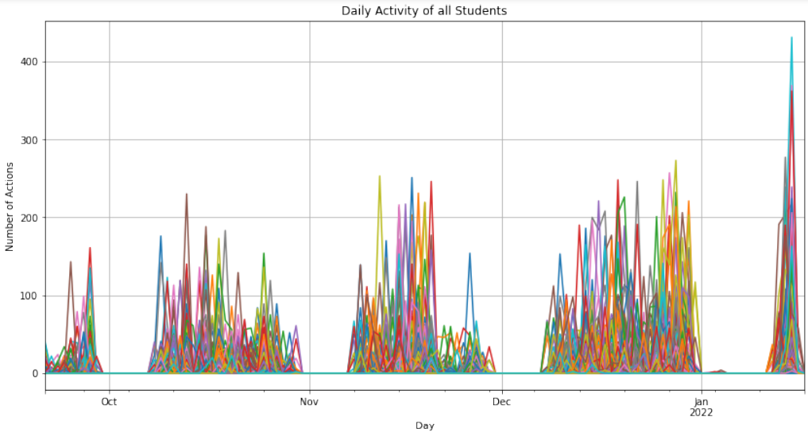
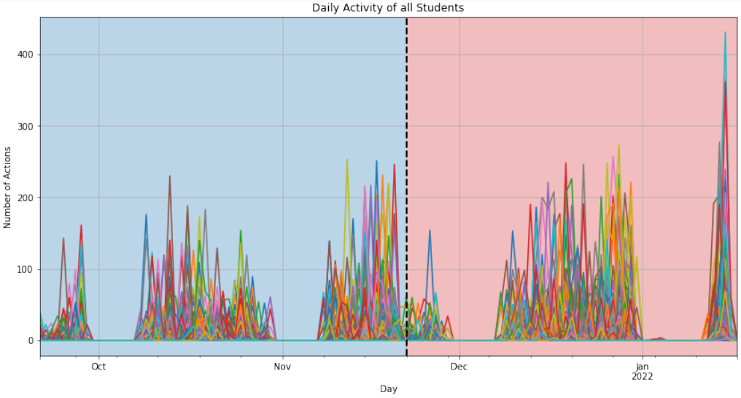
PWO Example 2: AI in Education
Situation:
Forecast students exam results based on their online activity

Slide 57
PWO Example 2: AI in Education
Situation:
Forecast students exam results based on their online activity
Aim:
Produce Early Predictions
Allow enough time for adjustments

Slide 58
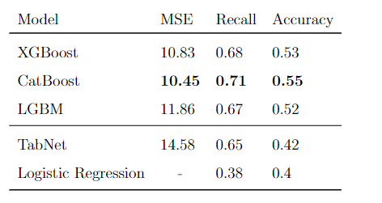
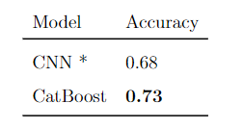
PWO Example 2: AI in Education
Situation:
Forecast students exam results based on their online activity
Aim:
Produce Early Predictions
Allow enough time for adjustments
Produce Accurate Predictions
Facilitate teacher’s decion making

Slide 59
PWO Example 2: AI in Education
Situation:
Forecast students exam results based on their online activity
Aim:
Produce Early Predictions
Allow enough time for adjustments
Produce Accurate Predictions
Facilitate teacher’s decion making
Bonus point:
Explainability

Slide 60
PWO Example 2: AI in Education
Situation:
Forecast students exam results based on their online activity
Aim:
Produce Early Predictions
Allow enough time for adjustments
Produce Accurate Predictions
Facilitate teacher’s decion making
Bonus point:
Explainability
Main Takeaway: GBDT models have high compatibility with explainability techniques

Slide 61
Justified or Not? The Case Against Statistical Models
Notable Limitations
By definition local models
Limited performance in a production environment
Missing values
Cold start
Small history
Intermittency

Slide 62
Justified or Not? The Case Against Statistical Models
Notable Limitations
By definition local models
Limited performance in a production environment
Missing values
Cold start
Small history
Intermittency
On the other hand:
They are less complex
We know how they work
They are battle-tested
They are very hard to beat at some tasks

Slide 63
Justified or Not? The Case Against Statistical Models
Notable Limitations
By definition local models
Limited performance in a production environment
Missing values
Cold start
Small history
Intermittency
On the other hand:
They are less complex
We know how they work
They are battle-tested
They are very hard to beat at some tasks
Main takeway: Always evaluate your fancy model with a good old Exponential Smoothing

Slide 64
Justified or Not? The Bandwagon of Deep Learning
What about the fancy model on paper X?

Slide 65
Justified or Not? The Bandwagon of Deep Learning
Quiz Time!
What about the fancy model on paper X?

Slide 66
Justified or Not? The Bandwagon of Deep Learning
Quiz Time!
How many parameters are included in GPT-3 (backbone of chatGPT)?
What about the fancy model on paper X?

Slide 67
Justified or Not? The Bandwagon of Deep Learning
Quiz Time!
How many parameters are included in GPT-3 (backbone of chatGPT)?
What about the fancy model on paper X?
Tip:
ResNet-200 –used as backbone for many Vision Tasks- has 66M.

Slide 68
Justified or Not? The Bandwagon of Deep Learning
Quiz Time!
2) How much time would it take to train GPT-3 on my Laptop
(Single mediocre GPU)
What about the fancy model on paper X?
Tip:
OpenAI paid approximately $5M to train the model.

Slide 69
Justified or Not? The Bandwagon of Deep Learning
Quiz Time!
3) In your opinion, how many research labs in the world can build ChatGPT-like models?
What about the fancy model on paper X?

Slide 70
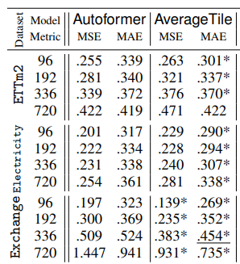
Justified or Not? The Bandwagon of Deep Learning
A very complex Transformer NN is outperformed by a very simple model with 0 trainable parameters.
What about the fancy model on paper X?
Be hesitant to jump on the bandwagon
Are these models properly evaluated?
Can they deployed in production?
Reported evidence of their limitations.
Sun, Fan-Keng, and Duane S. Boning. "Fredo: frequency domain-based long-term time series forecasting." arXiv preprint arXiv:2205.12301 (2022).
Grinsztajn, Léo, Edouard Oyallon, and Gaël Varoquaux. "Why do tree-based models still outperform deep learning on tabular data?." arXiv preprint arXiv:2207.08815 (2022).
Shwartz-Ziv, Ravid, and Amitai Armon. "Tabular data: Deep learning is not all you need." Information Fusion 81 (2022): 84-90.

Slide 71
Justified or Not? The Bandwagon of Deep Learning
A very complex Transformer NN is outperformed by a very simple model with 0 trainable parameters.
What about the fancy model on paper X?
Be hesitant to jump on the bandwagon
Are these models properly evaluated?
Can they deployed in production?
Reported evidence of their limitations.
But under the right conditions they show remarkable performance gains
“Building Deep Learning Architectures is more an art than a science” - François Chollet, creator of Keras.
Notable Examples: DeepAR, MQ-CNN, TFT, NBEATS, etc…
Sun, Fan-Keng, and Duane S. Boning. "Fredo: frequency domain-based long-term time series forecasting." arXiv preprint arXiv:2205.12301 (2022).
Grinsztajn, Léo, Edouard Oyallon, and Gaël Varoquaux. "Why do tree-based models still outperform deep learning on tabular data?." arXiv preprint arXiv:2207.08815 (2022).
Shwartz-Ziv, Ravid, and Amitai Armon. "Tabular data: Deep learning is not all you need." Information Fusion 81 (2022): 84-90.

Slide 72
Justified or Not? The Bandwagon of Deep Learning
A very complex Transformer NN is outperformed by a very simple model with 0 trainable parameters.
What about the fancy model on paper X?
Be hesitant to jump on the bandwagon
Are these models properly evaluated?
Can they deployed in production?
Reported evidence of their limitations.
But under the right conditions they show remarkable performance gains
“Building Deep Learning Architectures is more an art than a science” - François Chollet, creator of Keras.
Notable Examples: DeepAR, MQ-CNN, TFT, NBEATS, etc…
Sun, Fan-Keng, and Duane S. Boning. "Fredo: frequency domain-based long-term time series forecasting." arXiv preprint arXiv:2205.12301 (2022).
Main Takeaway:
Unless you have teams of successful Data Scientists, Data and ML Engineers, using NNs in productions might backfire. Use established NNs instead
Grinsztajn, Léo, Edouard Oyallon, and Gaël Varoquaux. "Why do tree-based models still outperform deep learning on tabular data?." arXiv preprint arXiv:2207.08815 (2022).
Shwartz-Ziv, Ravid, and Amitai Armon. "Tabular data: Deep learning is not all you need." Information Fusion 81 (2022): 84-90.

Slide 73
Deployment in Practice. Suggestions & Potential Pitfalls
Section 4.
Evaluate, Re-Evaluate and Evaluate Properly
Improve the Business Process and not the Model

Slide 74
Evaluate, Re-Evaluate and Evaluate Properly
On November 2021, Zillow announced that they were shutting Zillow offers.
Nearly $245M losses
People blamed the Data Science Forecasting team for using Prophet a model developed by Facebook.
Did they properly evaluate their models??

Slide 75
Evaluate, Re-Evaluate and Evaluate Properly
On November 2021, Zillow announced that they were shutting Zillow offers.
Nearly $245M losses
People blamed the Data Science Forecasting team for using Prophet a model developed by Facebook.
Did they properly evaluate their models??
Tips about evaluations:
People assume accuracy metrics are directly connected with business Metrics: WRONG
Use business metrics (if possible)
Pick 2 or more (and possibly uncorrelated) evaluation metrics
Use different metrics for stakeholders and different for evaluating the models
Do not evaluate on a single forecasting horizon, use cross-validation.
Test the model under different scenarios

Slide 76
Improve the Business Process not the Model
- Have clear understanding on what you want to forecast and why
What is the business problem you are trying to solve
Is forecasting the most effective solution?
Is the problem forecastable?

Slide 77
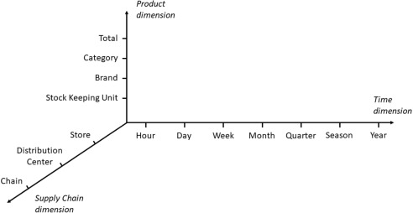
Improve the Business Process not the Model
- Have clear understanding on what you want to forecast and why
What is the business problem you are trying to solve
Is forecasting the most effective solution?
Is the problem forecastable?
- Design an Effective Forecasting Strategy before picking a model

Slide 78
Improve the Business Process not the Model
- Have clear understanding on what you want to forecast and why
What is the business problem you are trying to solve
Is forecasting the most effective solution?
Is the problem forecastable?
- Design an Effective Forecasting Strategy before picking a model
- Build a Forecasting System
Models are just a small piece to the forecasting puzzle
Data storage, Data pipelines, Decision Making Systems
Build vs Buy: Minimizes expenses by drawing cost-efficient deployment plans.
Cloud vs Local infrastructures

Slide 79
The end ☺
Questions?
Filotas Theodosiou
Contact Details:
- filotas.Theodosiou@vives.be
- www.linkedin.com/in/filotas-theodosiou

